Slide 1
Ripple Carry Adder with Testbench and Layout
EEE 468- VLSI Laboratory
Level 4 Term 2
Final Presentation
Submitted by – Group 8
Lab Group- G1
Tasmin Khan
1906055
Tanvir Hossain
1906040

Slide 2
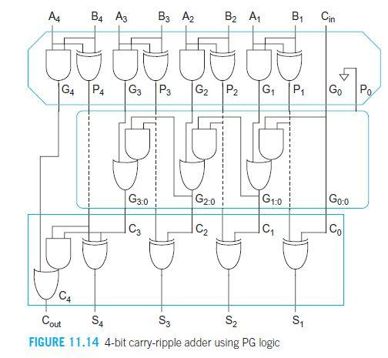
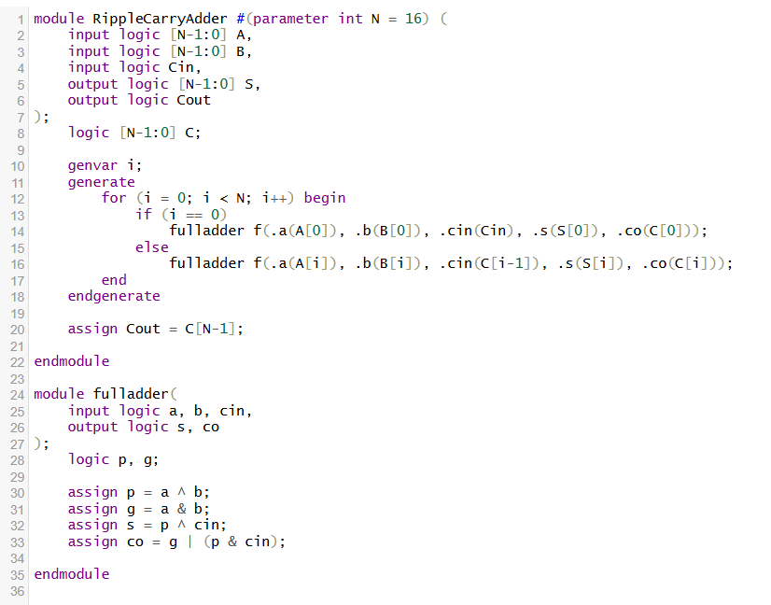
Ripple Carry Adder module design

Slide 3
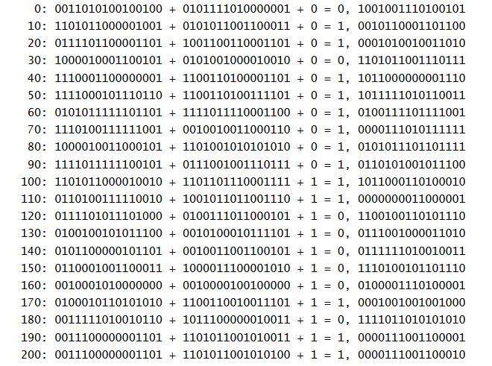
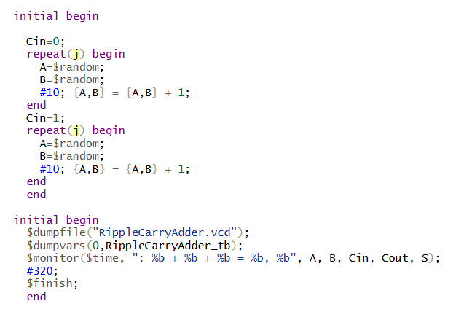
Ripple Carry Adder Flat Testbench

Slide 4
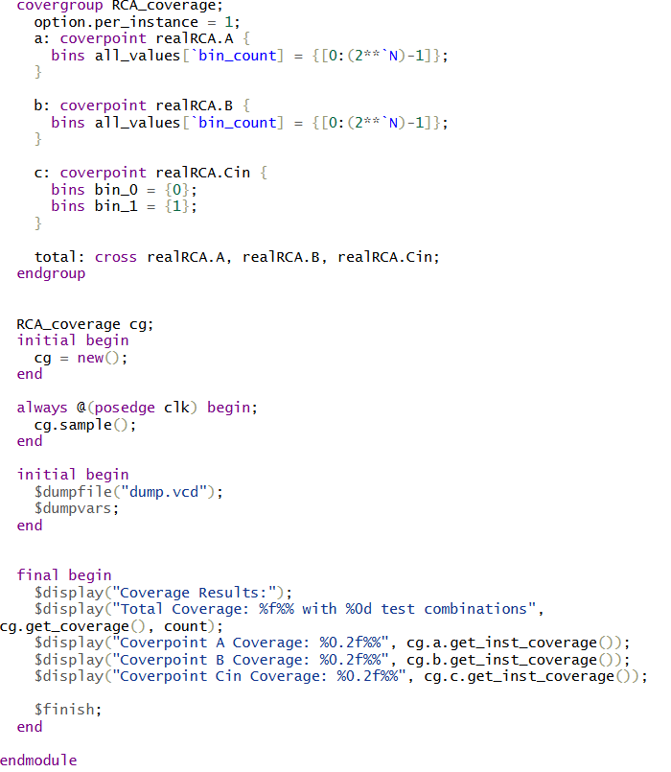
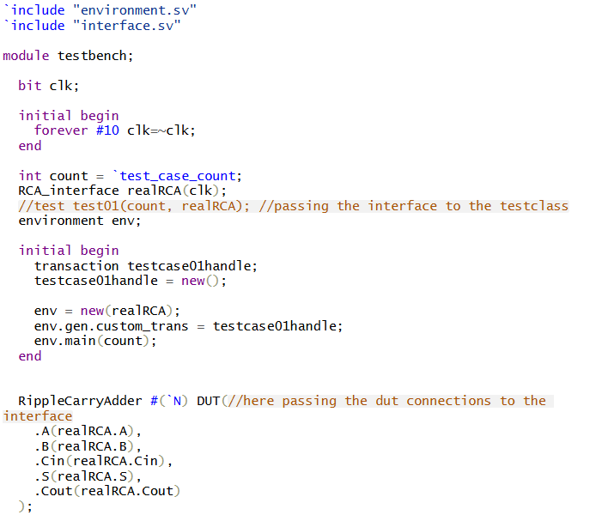
RCA Layered Testbench Design: testbench module

Slide 5
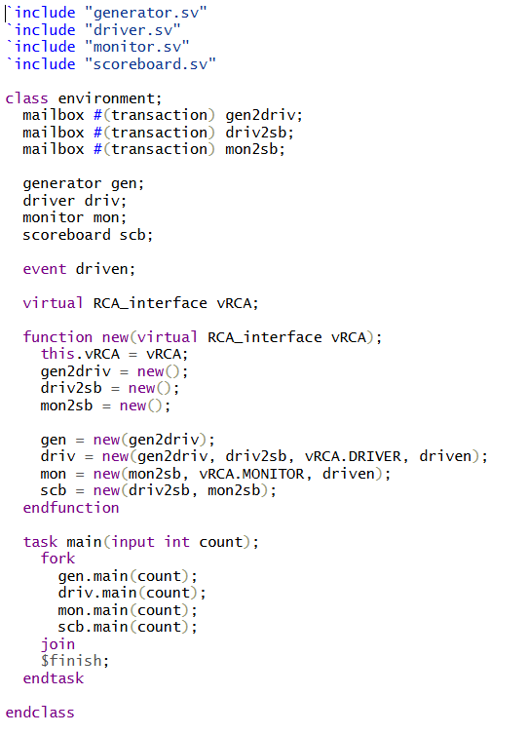
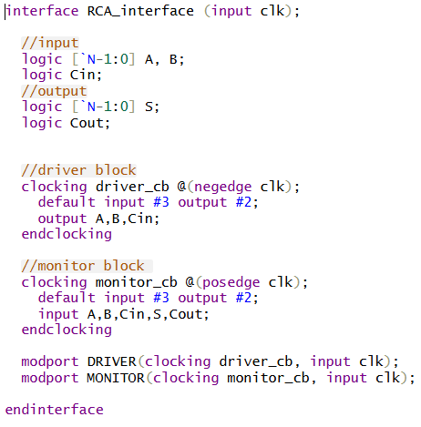
Interface class Environment Class

Slide 6
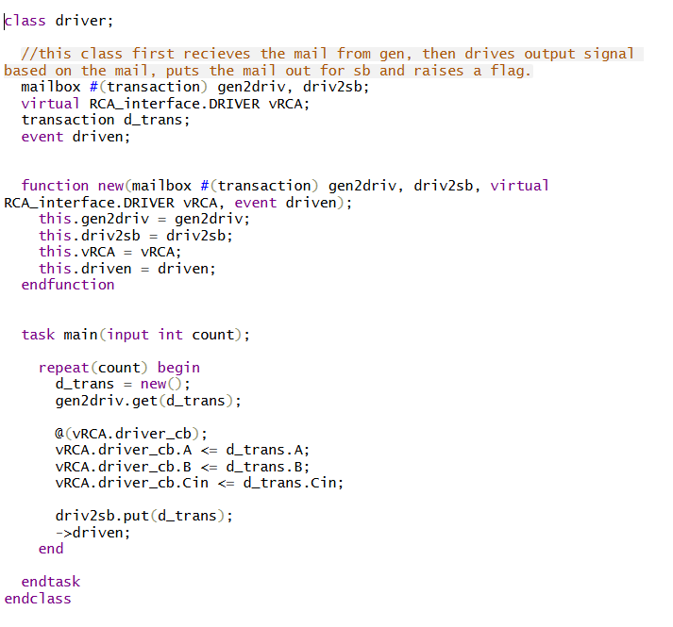
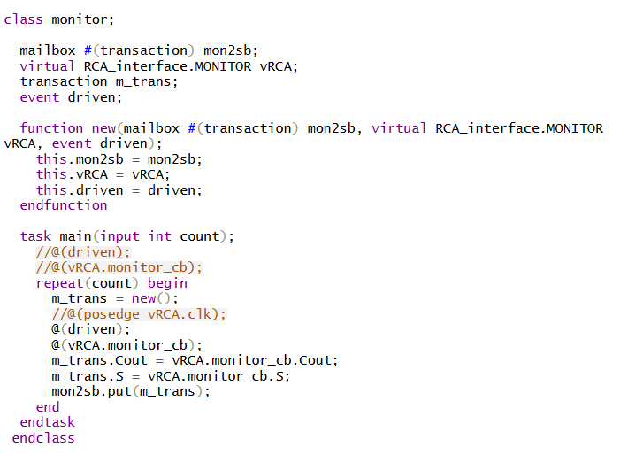
Driver class Monitor Class

Slide 7
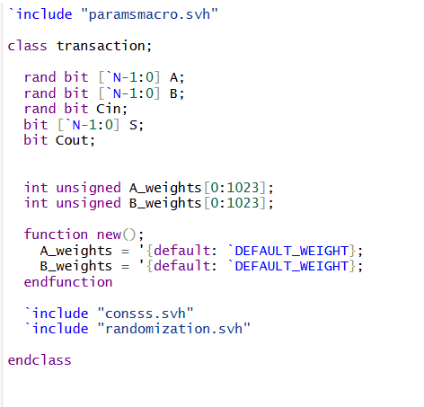
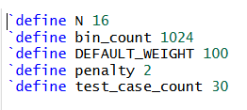
transaction class parameter headers

Slide 8
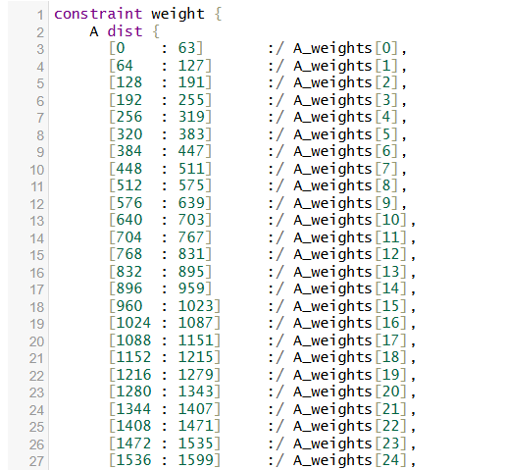
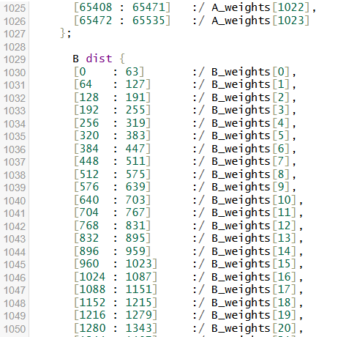
Constraints header on distribution of bins for A and B datapoints

Slide 9
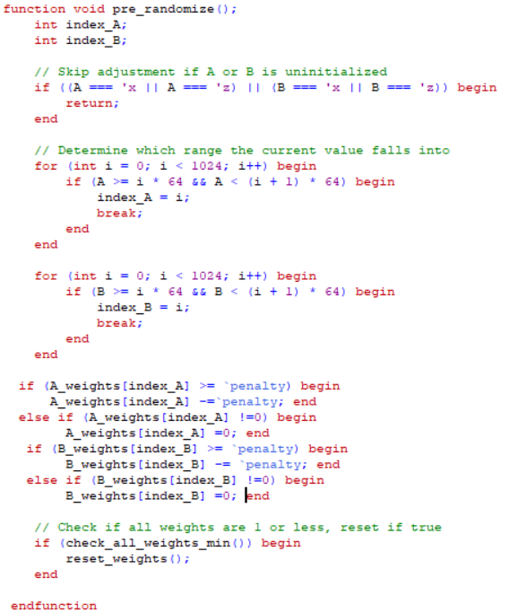
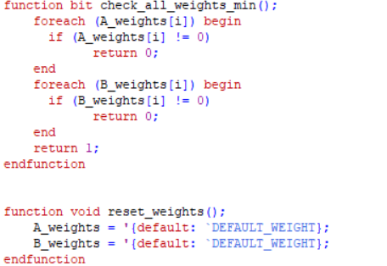
Pre-randomize function

Slide 10
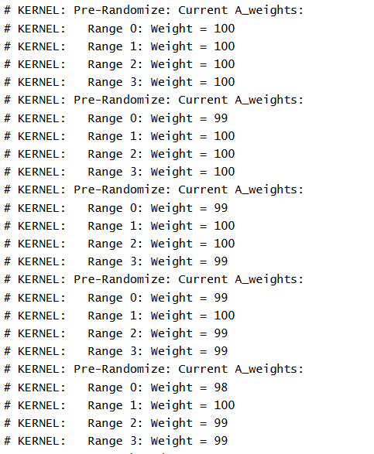
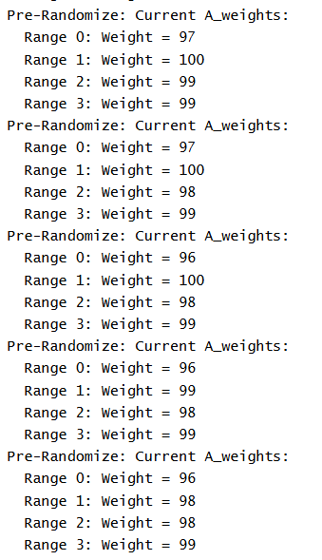
Skewed Distribution Example for weights of A datapoints

Slide 11
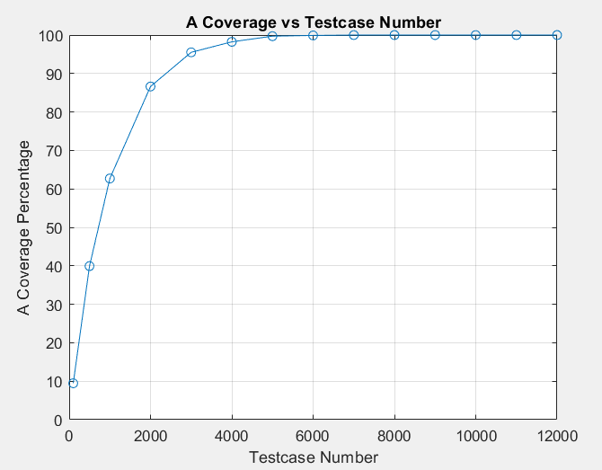
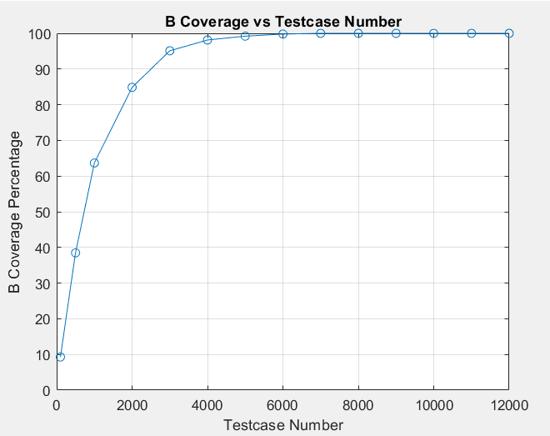
Regular coverage vs testcases trend for A and B

Slide 12
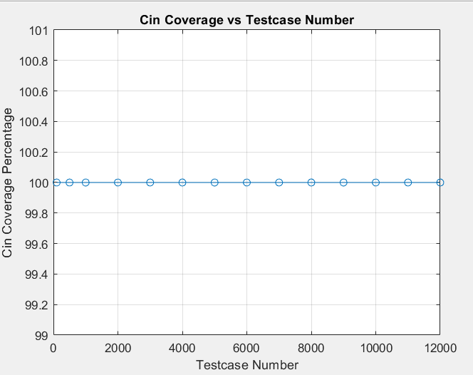
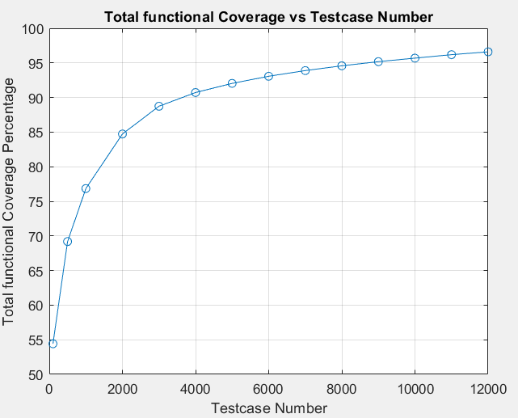
Regular coverage vs testcases trend for Cin and Total Cross

Slide 13
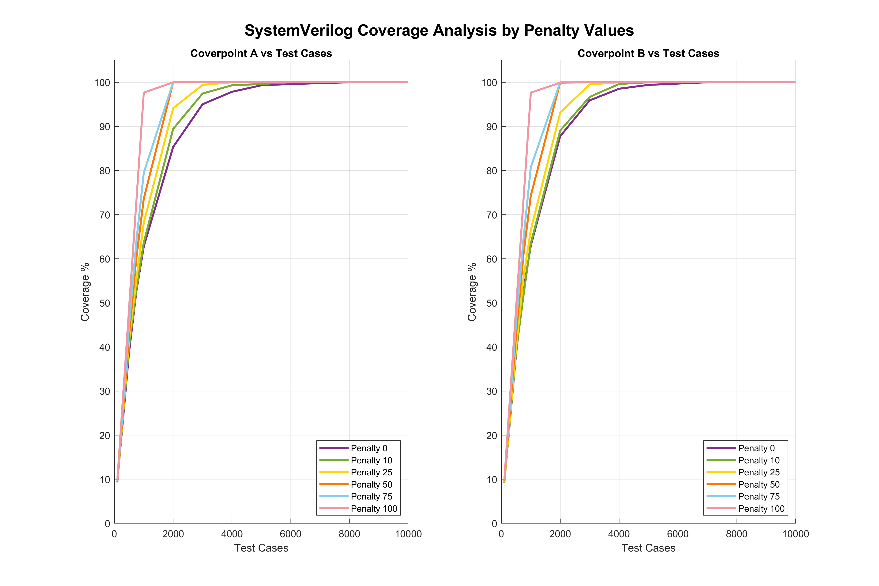
Penalized coverage

Slide 14
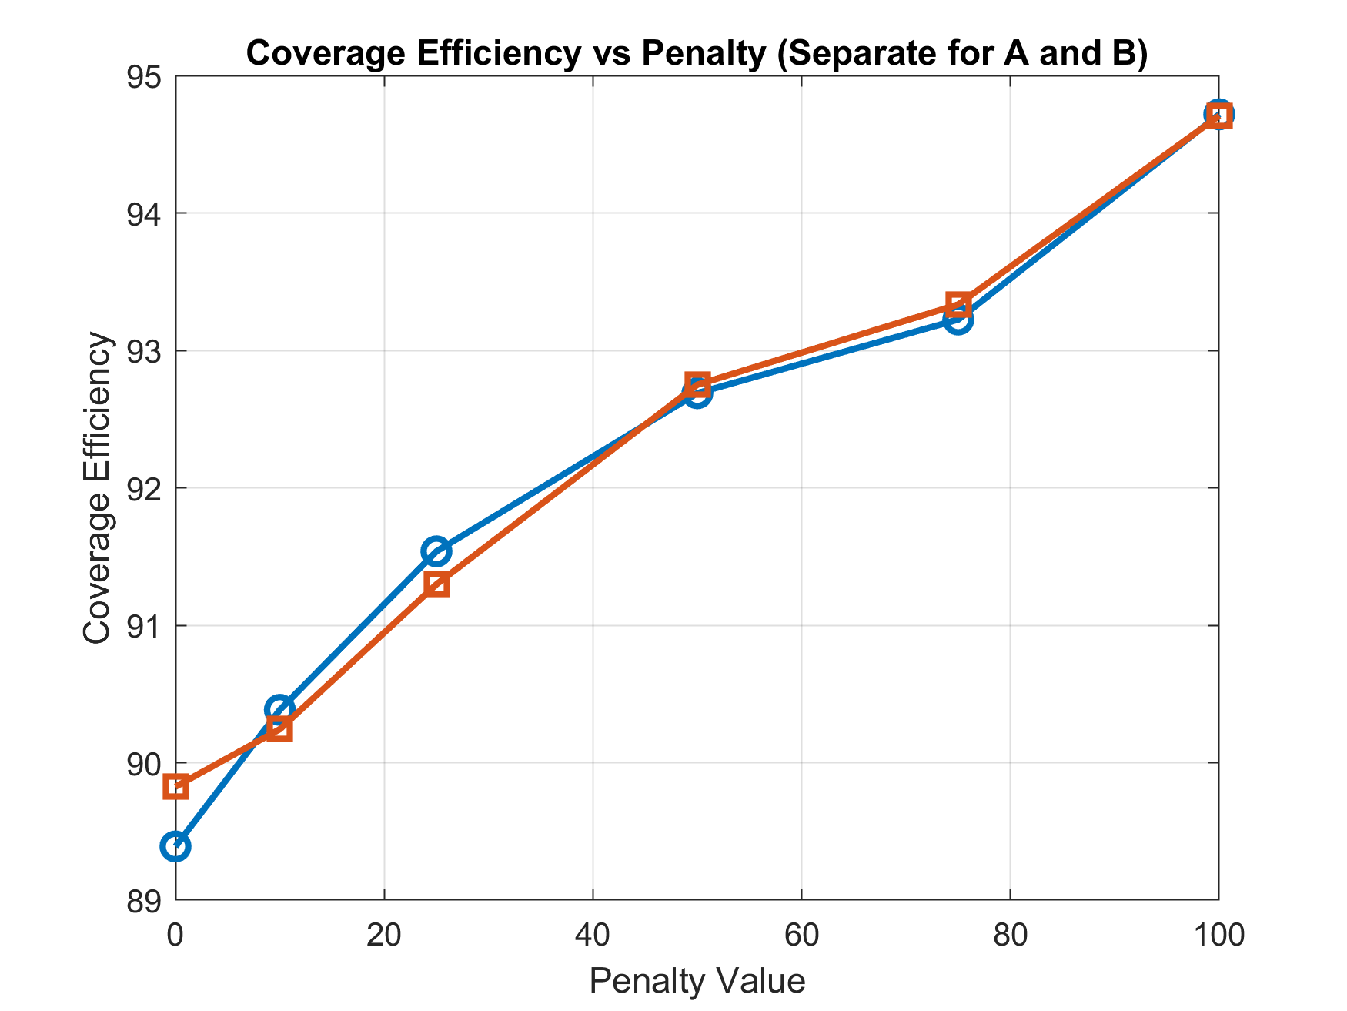
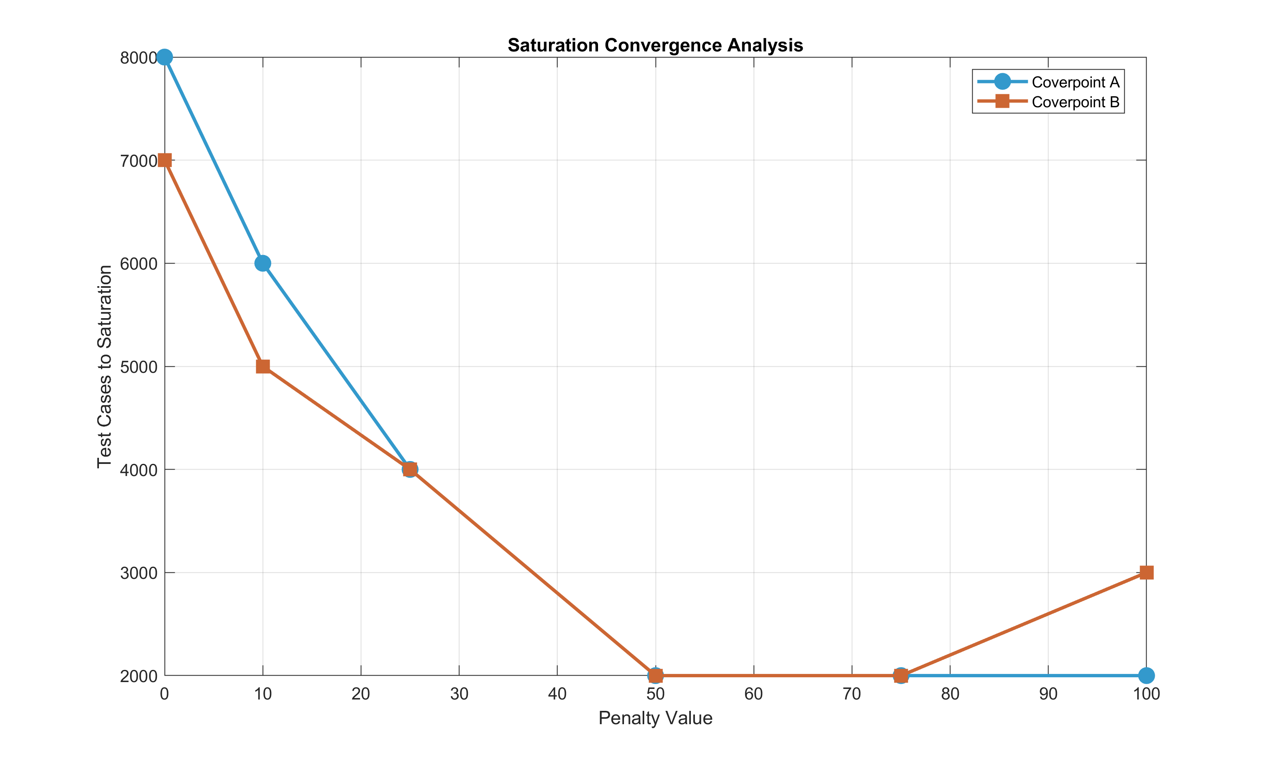
Penalized coverage for coverpoints A and B with 1024 bins

Slide 15
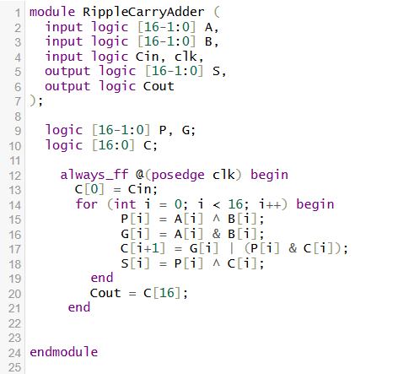
RCA combinational vs sequential design

Slide 16
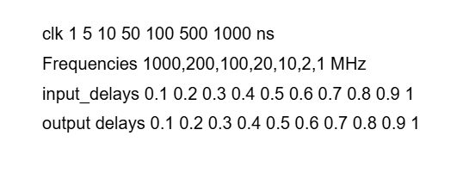
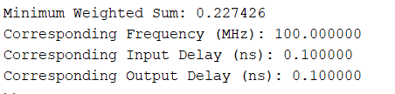
TCL file setup values
Expression for choosing optimum values
Finding minimum condition

Slide 17
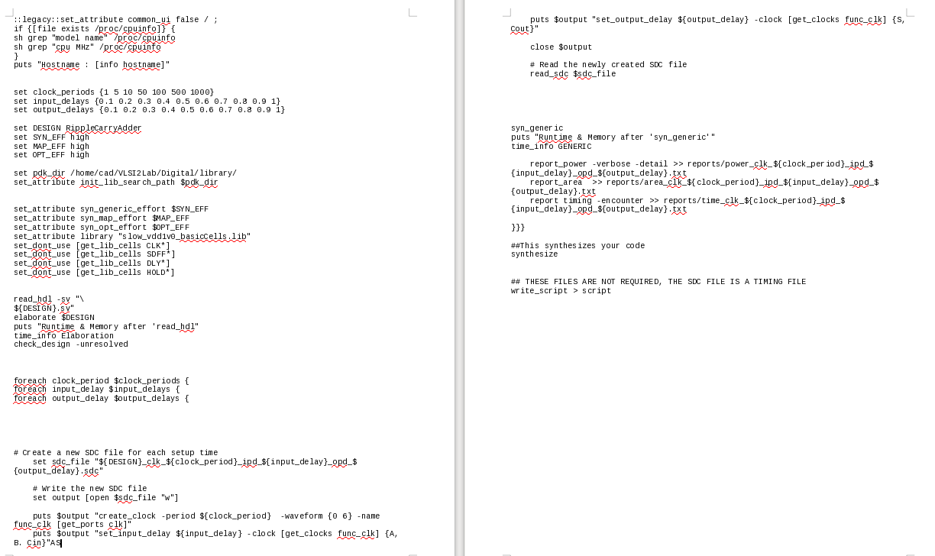
TCL file to generate SDC files

Slide 18
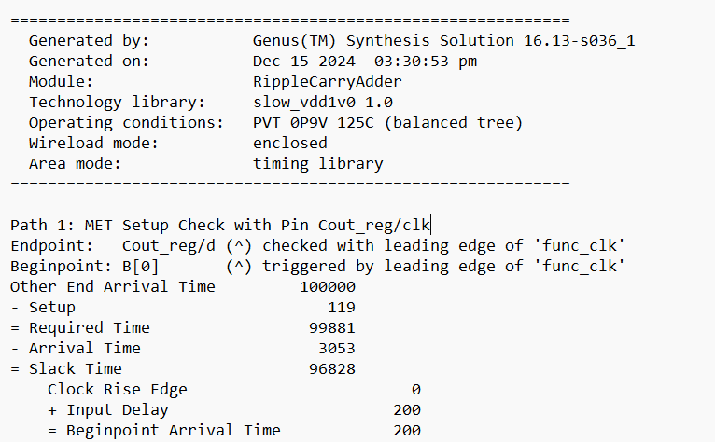
Static timing analysis

Slide 19
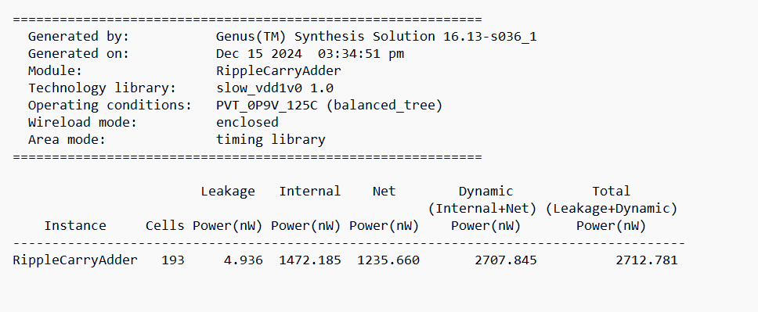
Power consumption

Slide 20
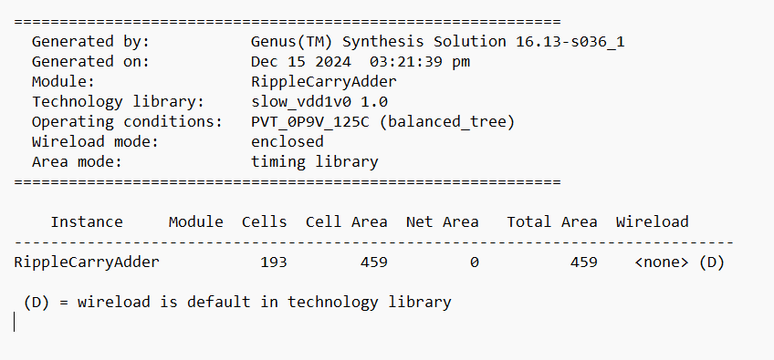
Cells and cell area

Slide 21
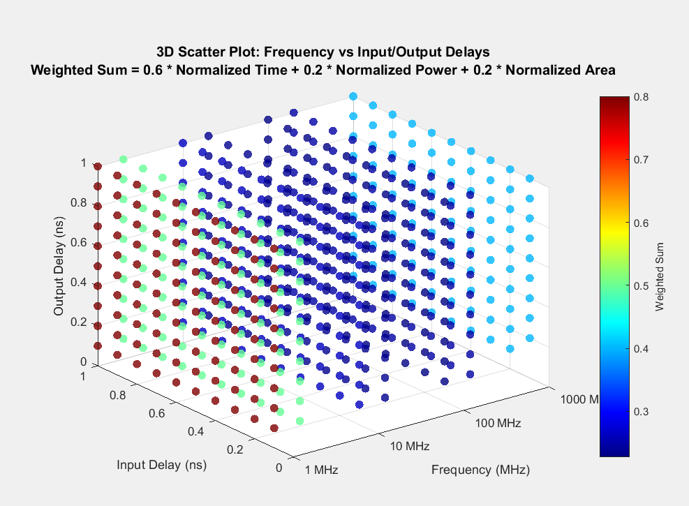

Slide 22
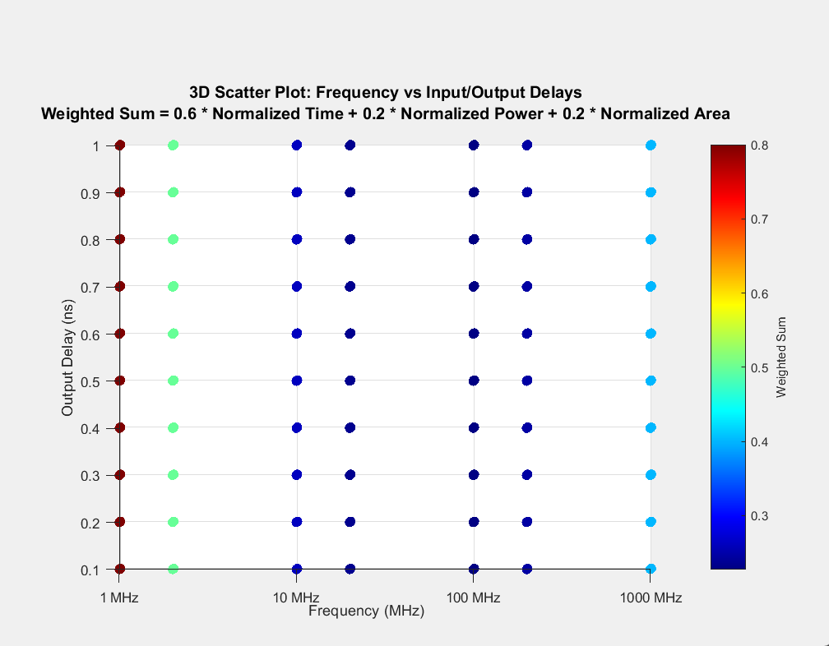

Slide 23
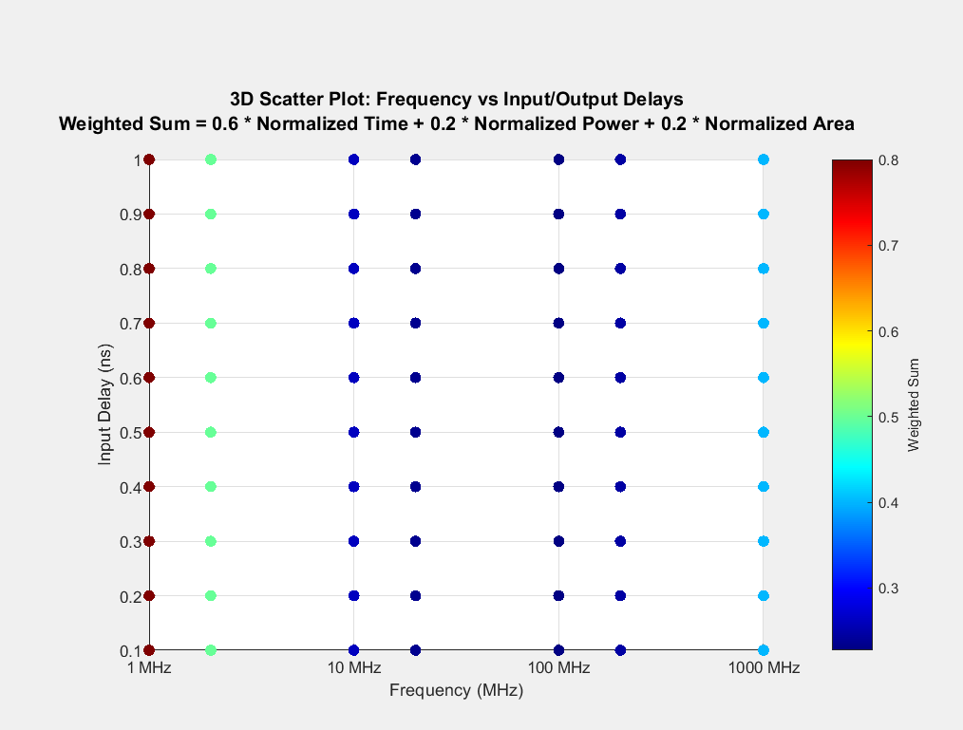

Slide 24
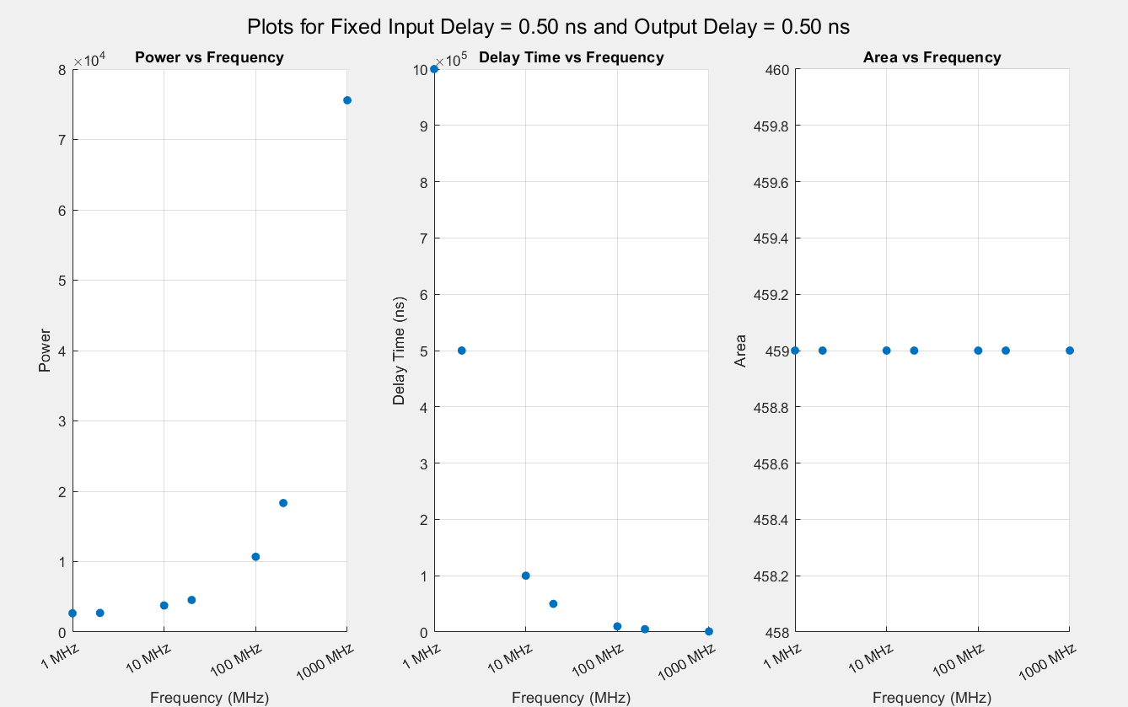

Slide 25
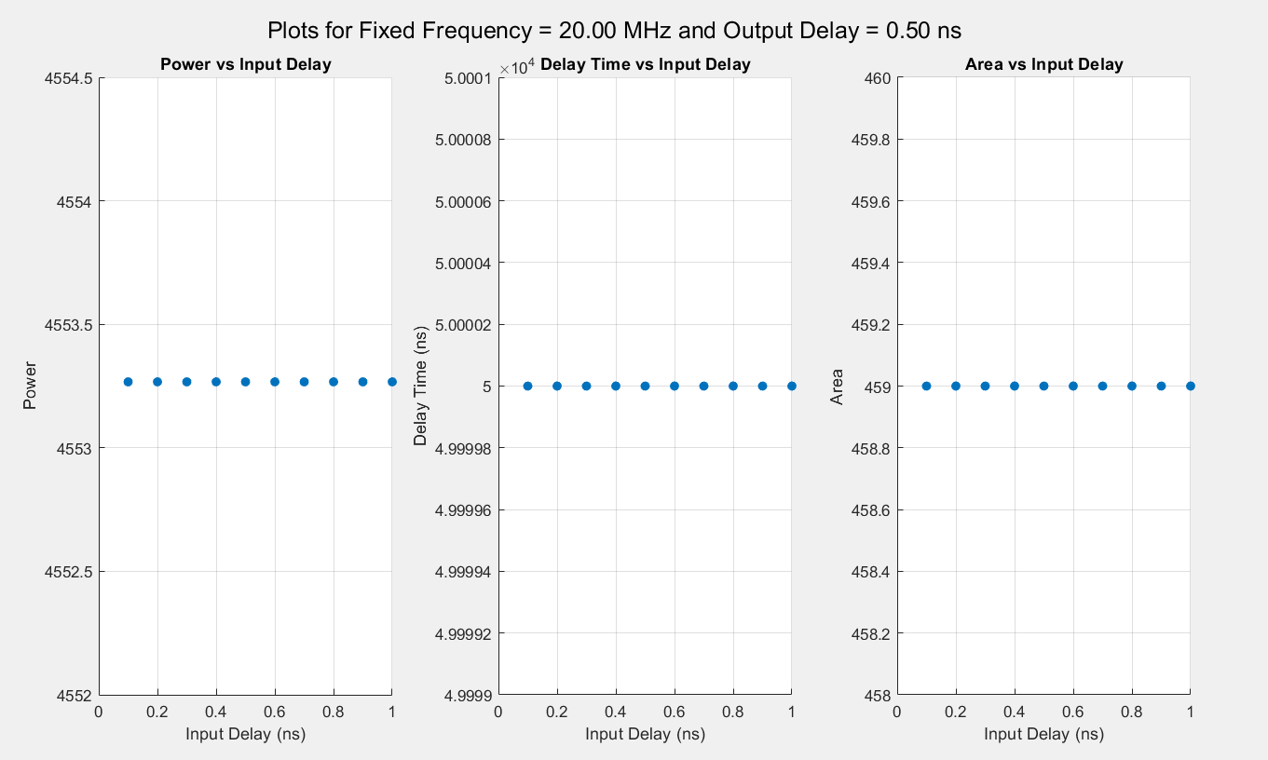

Slide 26
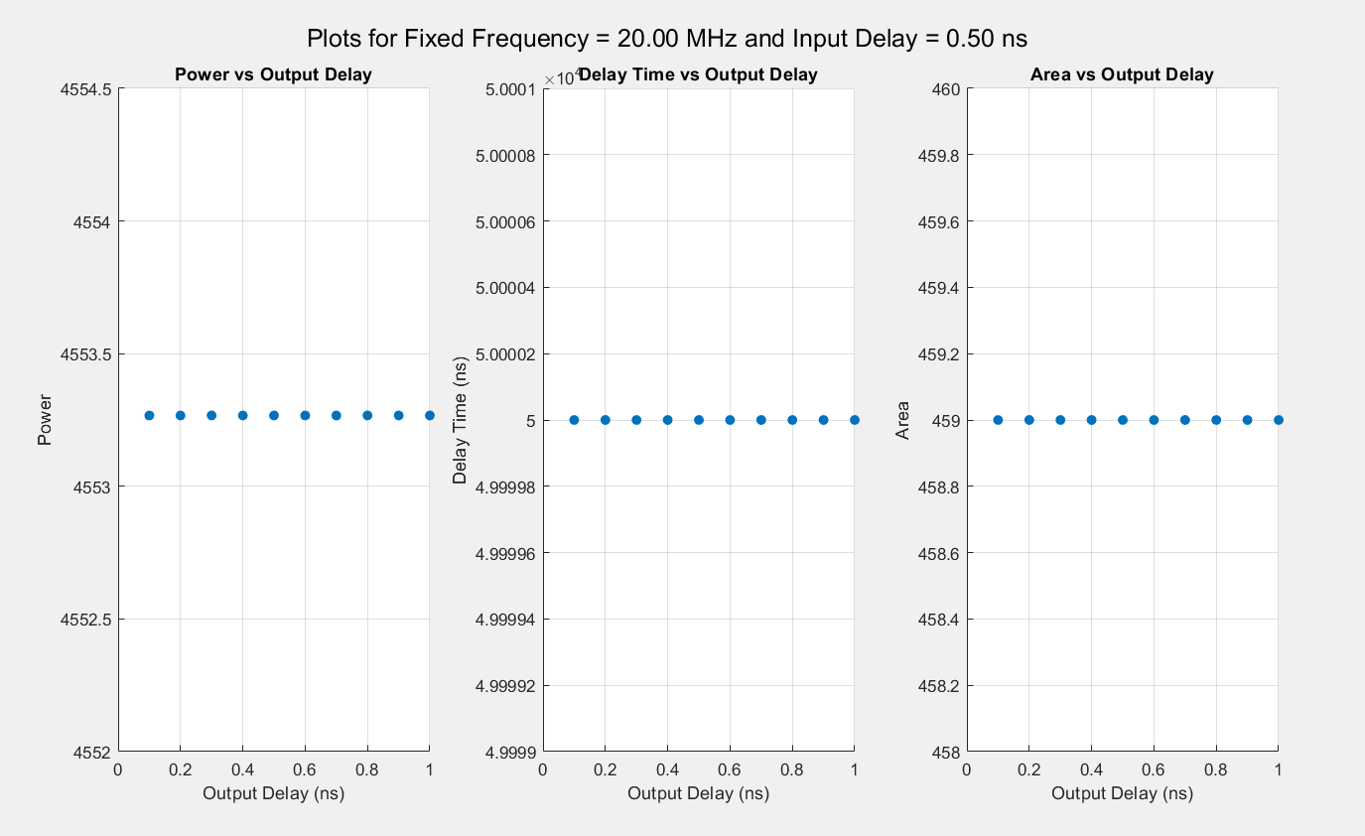

Slide 27
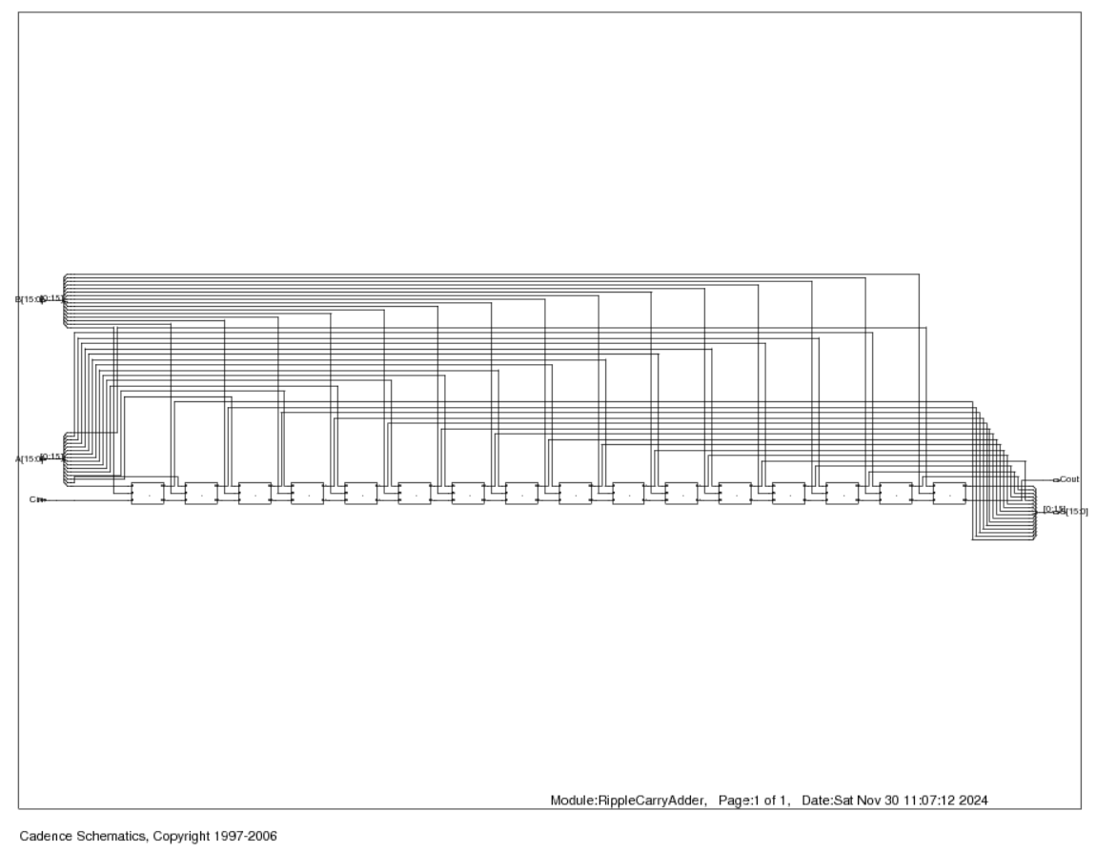
Generated circuit schemaitc

Slide 28
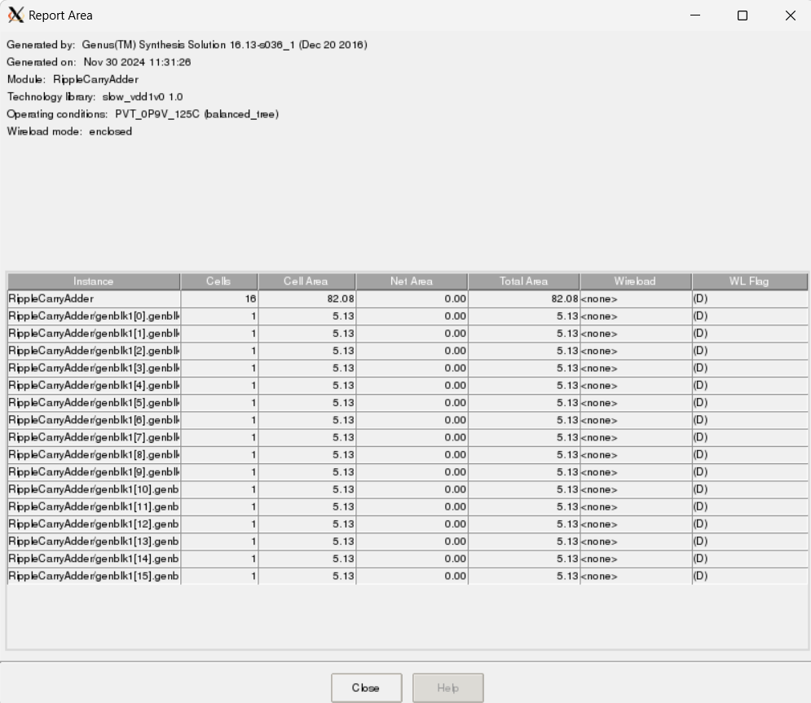
Area Report

Slide 29
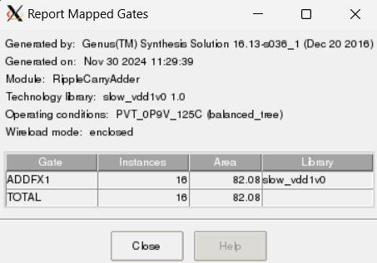
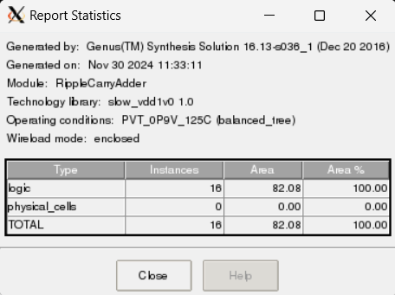
Gate and Logic cell report

Slide 30
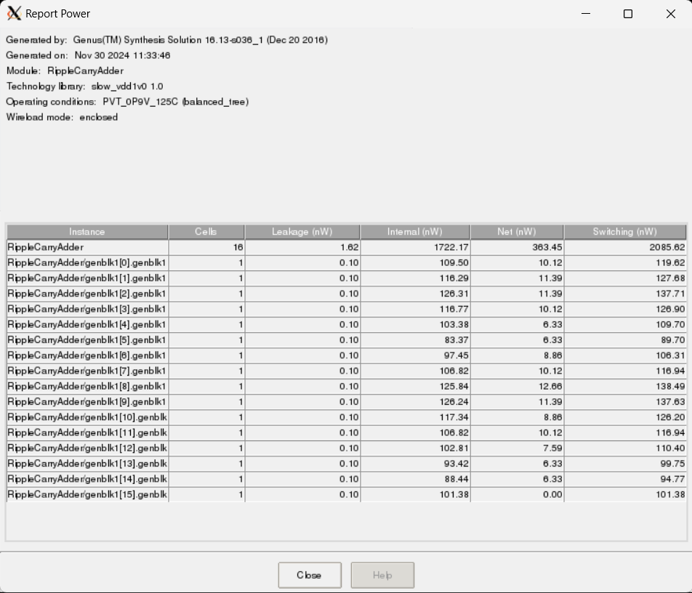
Power Report

Slide 31
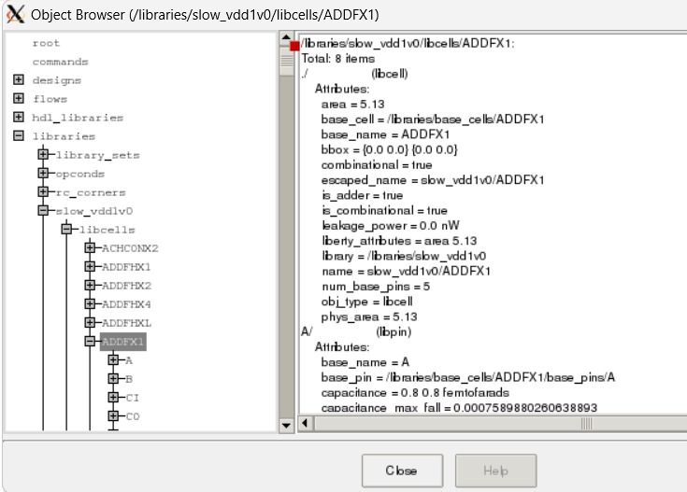
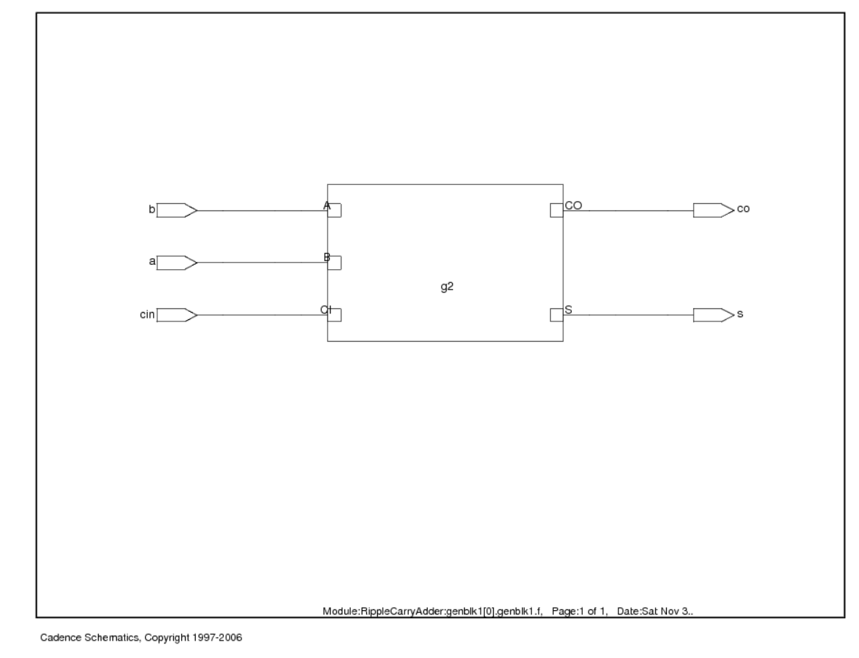
Base cell Properties

Slide 32
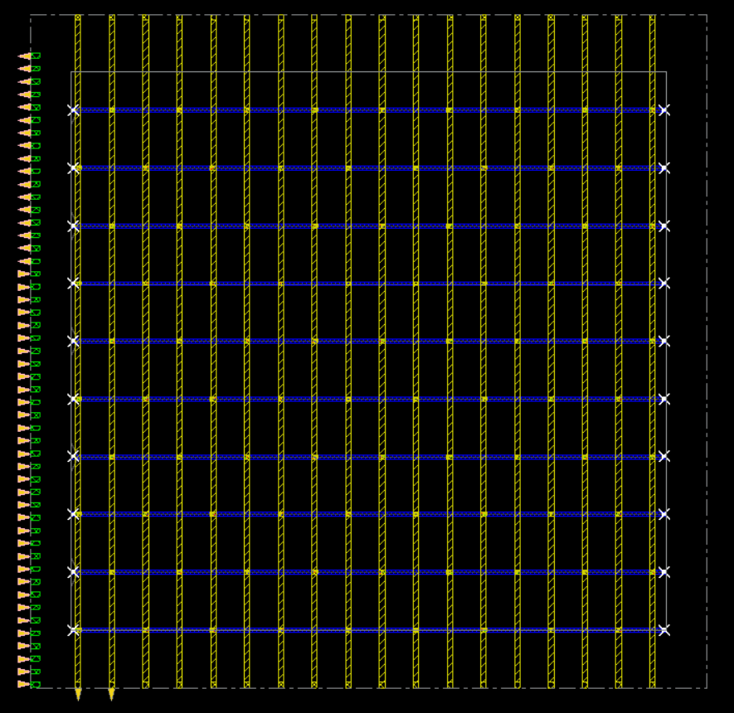
Power mesh Grid
Die Size: 20 µm × 20 µm

Slide 33
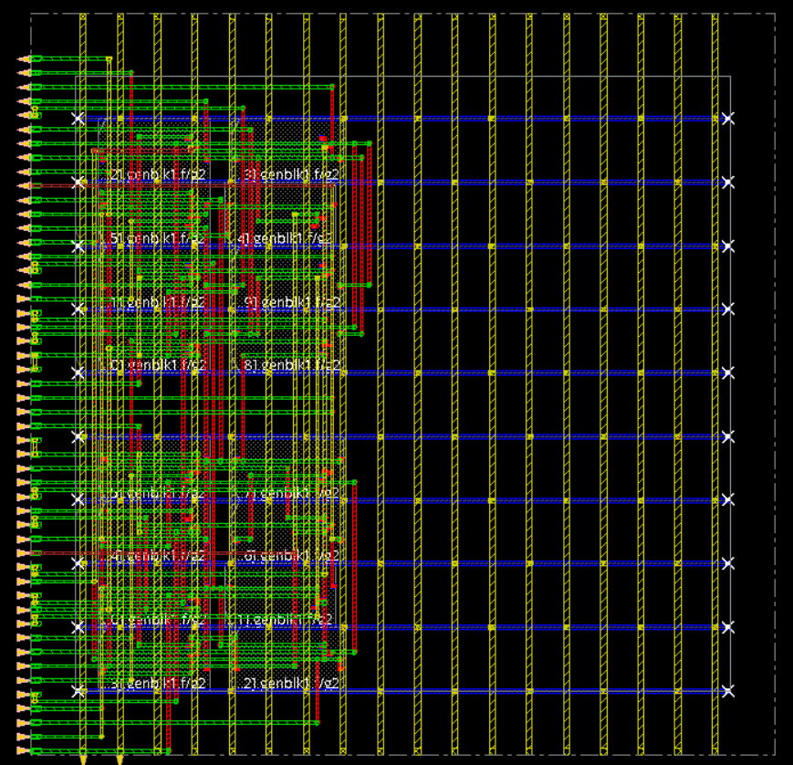
Cell placement

Slide 34
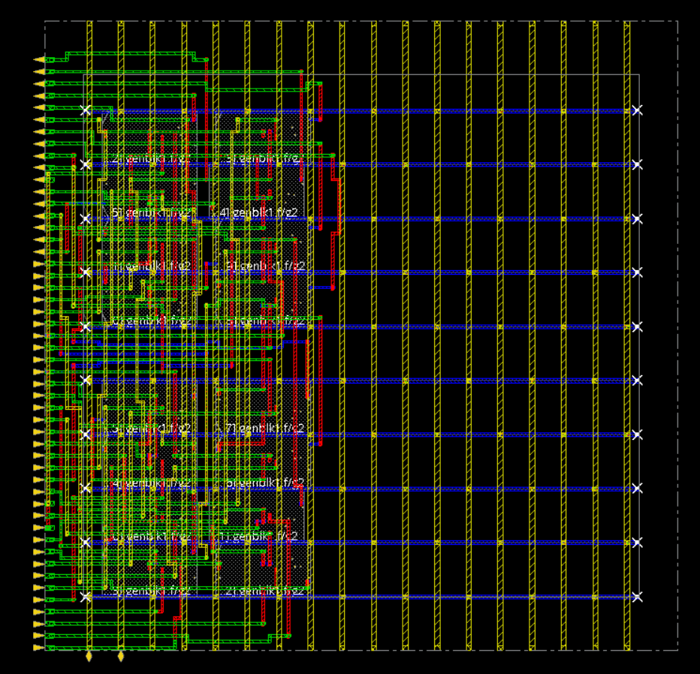
Nano routing

Slide 35
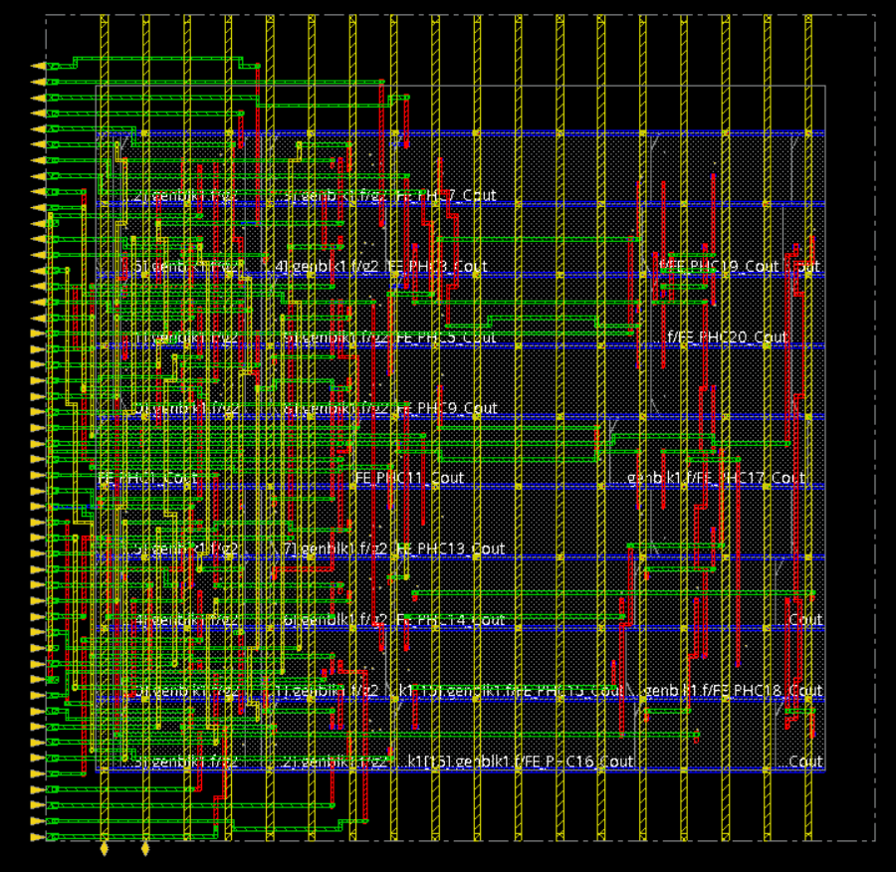
Power and routing

Slide 36
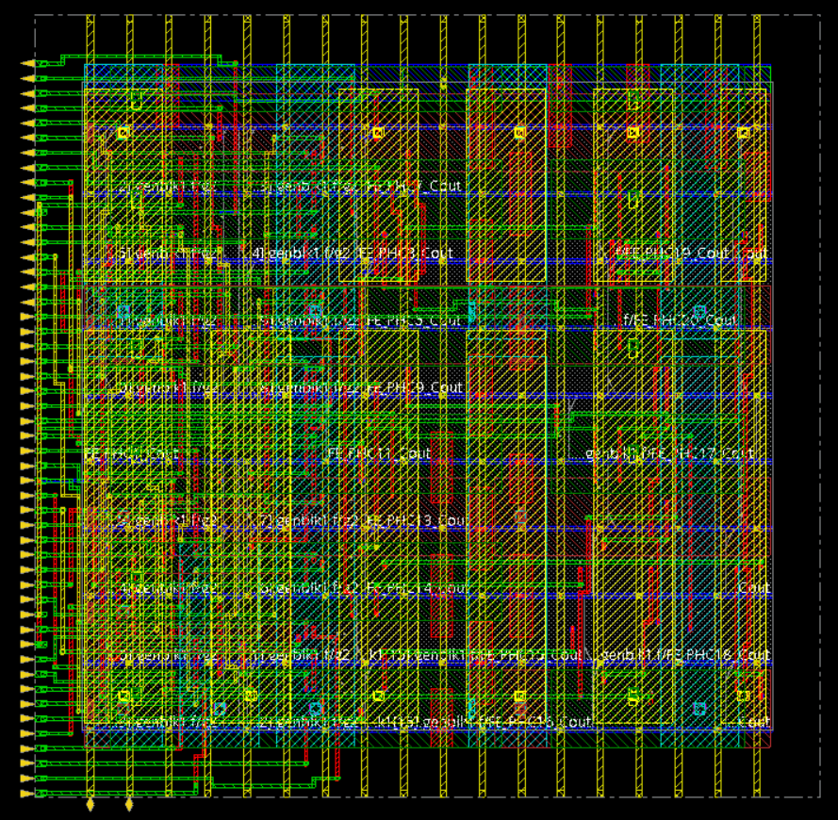
Filler cells
And Metal Fill

Slide 37

Cell Density

Slide 38


Connectivity and geometry verification

Slide 39


Full Layout
zoomed in view

Slide 40


DRC and LVS clearance

Slide 41

Power mesh Grid
(smaller area) V2
Die Size: 12 µm × 15 µm

Slide 42

Cell placement

Slide 43

Nano Routing
and Filler cell

Slide 44

Metal Fill

Slide 45

Cell Density

Slide 46

Full Layout

Slide 47

DRC and LVS clearance

Slide 48

Power mesh Grid
(smallest area) V3
Die Size: 10 µm × 10 µm

Slide 49

Cell density > 100%
Error
Hence, optimum choice is 12 um by 15 um

